Slide 1
أكـــــاديميــــة طــــويـــق
Deep Learning

Slide 2
Popular CNN Architectures
LeNet, AlexNet
By: Dr. Afshan Hashmi

Slide 3
Course Objectives:
Understanding the popular CNN Architectures
Explaining LeNet Architecture and Its Layers.
Explaining AlexNet Architecture and Its Layers.
Implementing LeNet and AlexNet Architecture on Google Colab

Slide 4
Introduction to CNN Architectures
Convolutional Neural Networks (CNNs) are the backbone of modern computer vision. Different architectures have been developed over time, each improving upon the previous ones in terms of accuracy, efficiency, and depth. This covers:
LeNet-5 (1998) – The first successful CNN
AlexNet (2012) – Revolutionized deep learning
VGG (2014) – Standardized deep CNNs
ResNet (2015) – Introduced skip connections
Inception (2014) – Used parallel convolutions

Slide 5
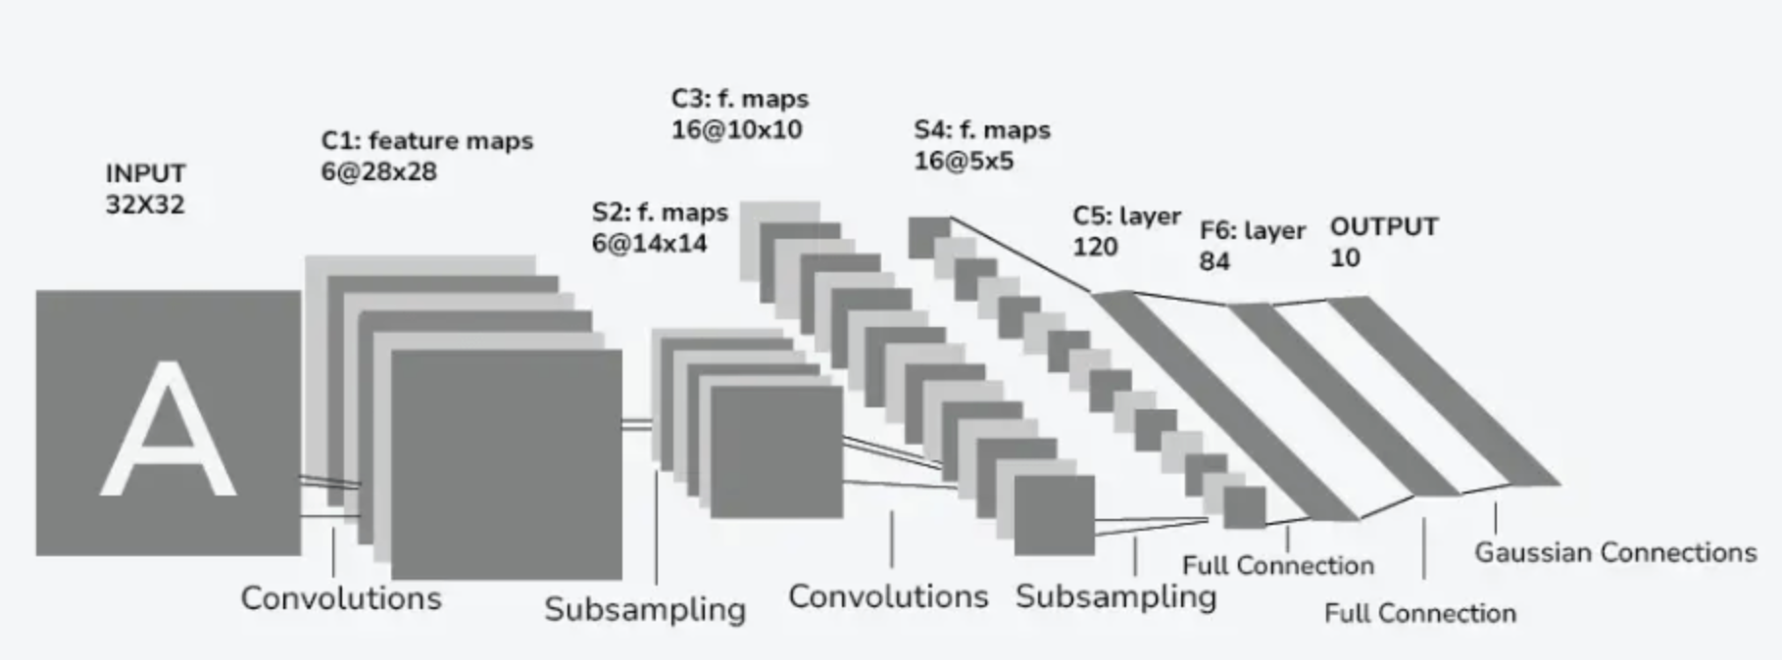
What is LeNet?
LeNet is a seminal convolutional neural network architecture developed by Yann LeCun and colleagues, pivotal in revolutionizing image recognition through its innovative design and influential principles. The article provides a comprehensive exploration of LeNet, elucidating its architecture, historical context, significance in deep learning, and diverse applications across various domains.

Slide 6
Understanding LeNet
LeNet was developed by Yann LeCun and his colleagues in the late 1980s and early 1990s.
It is one of the earliest convolutional neural networks and significantly influenced deep learning, especially in image recognition.
It was originally designed to recognize handwritten and machine-printed characters.
The LeNet-5 architecture includes convolutional layers, followed by subsampling, and then fully connected layers.
It culminates in a softmax output layer.
This layer arrangement was designed for automatic feature learning from input images, moving away from manual feature engineering.
LeNet set a new standard for machine learning applications in image recognition.

Slide 7
Significance of LeNet
LeNet was a groundbreaking early demonstration of the successful application of Convolutional Neural Networks (CNNs) to visual pattern recognition.
It introduced fundamental CNN concepts that are now standard, including:Multiple convolutional layers.
Multiple pooling layers.
Local receptive fields.
Shared weights.
The backpropagation algorithm for network training.
LeNet's innovations were foundational for the development of more intricate and deeper networks.
These deeper networks are now essential to modern AI systems across diverse applications, from self-driving cars to medical diagnosis.
The core principles established by LeNet have endured and been built upon.
This has led to the creation of more advanced deep learning frameworks that continue to expand the capabilities of machine learning.

Slide 8
Chronological summary of the LeNet architecture's development:
Late 1980s: Yann LeCun starts foundational work on CNNs at AT&T Bell Labs, leading to initial LeNet models.
1989: LeNet-1, the first version, is introduced, using backpropagation for training convolutional layers.
1998: LeNet-5, the most significant version, is detailed in "Gradient-Based Learning Applied to Document Recognition," optimized for digit recognition and showing practical uses.
2000s: LeNet's success inspires further research and adaptations in fields beyond digit recognition, such as medical imaging and object recognition.
2010s and Beyond: LeNet's principles influence the creation of more advanced CNN architectures like AlexNet and ResNet, establishing its lasting impact on deep learning.

Slide 9
Breakdown of the LeNet architecture's layers:
The architecture of LeNet 5 contains 7 layers excluding the input layer.
1. Input Layer
Input Size: 32x32 pixels.
The input is larger than the largest character in the database, which is at most 20x20 pixels, centered in a 28x28 field. The larger input size ensures that distinctive features such as stroke endpoints or corners can appear in the center of the receptive field of the highest-level feature detectors.
Normalization: Input pixel values are normalized such that the background (white) corresponds to a value of 0, and the foreground (black) corresponds to a value of 1. This normalization makes the mean input roughly 0 and the variance roughly 1, which accelerates the learning process.

Slide 10
Breakdown of the LeNet architecture's layers:
2. Layer C1 (Convolutional Layer)
Feature Maps: 6 feature maps.
Connections: Each unit is connected to a 5x5 neighborhood in the input, producing 28x28 feature maps to prevent boundary effects.
Parameters: 156 trainable parameters and 117,600 connections.
3. Layer S2 (Subsampling Layer)
Feature Maps: 6 feature maps.
Size: 14x14 (each unit connected to a 2x2 neighborhood in C1).
Operation: Each unit adds four inputs, multiplies by a trainable coefficient, adds a bias, and applies a sigmoid function.
Parameters: 12 trainable parameters and 5,880 connections.

Slide 11
Breakdown of the LeNet architecture's layers:
4. Layer C3 (Convolutional Layer)
Feature Maps: 16 feature maps.
Connections: Each unit is connected to several 5x5 neighborhoods at identical locations in a subset of S2’s feature maps.
Parameters and Connections: Connections are partially connected to force feature maps to learn different features, with 1,516 trainable parameters and 151,600 connections.
5. Layer S4 (Subsampling Layer)
Feature Maps: 16 feature maps.
Size: 7x7 (each unit connected to a 2x2 neighborhood in C3).
Parameters: 32 trainable parameters and 2,744 connections.

Slide 12
Breakdown of the LeNet architecture's layers:
6. Layer C5 (Convolutional Layer)
Feature Maps: 120 feature maps.
Size: 1x1 (each unit connected to a 5x5 neighborhood on all 16 of S4’s feature maps, effectively fully connected due to input size).
Parameters: 48,000 trainable parameters and 48,000 connections.
7. Layer F6 (Fully Connected Layer)
Units: 84 units.
Connections: Each unit is fully connected to C5, resulting in 10,164 trainable parameters.
Activation: Uses a scaled hyperbolic tangent function f(a)=Atan⁡(Sa)f(a)=Atan(Sa), where A = 1.7159 and S = 2/3

Slide 13
Breakdown of the LeNet architecture's layers:
8. Output Layer
In the output layer of LeNet, each class is represented by an Euclidean Radial Basis Function (RBF) unit. Here's how the output of each RBF unit yiyi​is computed:
yi=∑xj.wij
In this equation:
xj represents the inputs to the RBF unit.
Wij represents the weights associated with each input.
The summation is over all inputs to the RBF unit.
In essence, the output of each RBF unit is determined by the Euclidean distance between its input vector and its parameter vector. The larger the distance between the input pattern and the parameter vector, the larger the RBF output. This output can be interpreted as a penalty term measuring the fit between the input pattern and the model of the class associated with the RBF unit.

Slide 14
Detailed Explanation of the Layers :
Convolutional Layers (Cx): These layers apply convolution operations to the input, using multiple filters to extract different features. The filters slide over the input image, computing the dot product between the filter weights and the input pixels. This process captures spatial hierarchies of features, such as edges and textures.
Subsampling Layers (Sx): These layers perform pooling operations (average pooling in the case of LeNet-5) to reduce the spatial dimensions of the feature maps. This helps to control overfitting, reduce the computational load, and make the representation more compact.
Fully Connected Layers (Fx): These layers are densely connected, meaning each neuron in these layers is connected to every neuron in the previous layer. This allows the network to combine features learned in previous layers to make final predictions.
The overall architecture of LeNet-5, with its combination of convolutional, subsampling, and fully connected layers, was designed to be both computationally efficient and effective at capturing the hierarchical structure of handwritten digit images. The careful normalization of input values and the structured layout of receptive fields contribute to the network's ability to learn and generalize from the training data effectively.

Slide 15
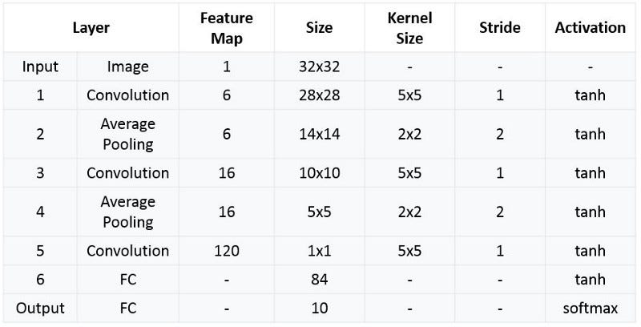
Summary of LeNet Architecture

Slide 16
AlexNet Convolutional Neural Network
AlexNet is a convolutional neural network designed for image classification.
It gained significant recognition for its performance in the ImageNet Large Scale Visual Recognition Challenge (ILSVRC).
It can classify images into 1,000 different object categories.
It is considered the first widely acknowledged successful application of deep convolutional networks for large-scale visual recognition.
Developed in 2012 by Alex Krizhevsky, Ilya Sutskever, and Geoffrey Hinton at the University of Toronto.
The model contains 60 million parameters and 650,000 neurons.
A key finding of the original research was the crucial role of the model's depth in achieving high performance.
Training was computationally intensive but made possible by using Graphics Processing Units (GPUs).

Slide 17
AlexNet Convolutional Architecture
This was the first architecture that used GPU to boost the training performance.
AlexNet consists of 5 convolution layers, 3 max-pooling layers, 2 Normalized layers, 2 fully connected layers and 1 SoftMax layer.
Each convolution layer consists of a convolution filter and a non-linear activation function called “ReLU”.
The pooling layers are used to perform the max-pooling function and the input size is fixed due to the presence of fully connected layers.
The input size is mentioned at most of the places as 224x224x3 but due to some padding which happens it works out to be 227x227x3.
Above all this AlexNet has over 60 million parameters.

Slide 18
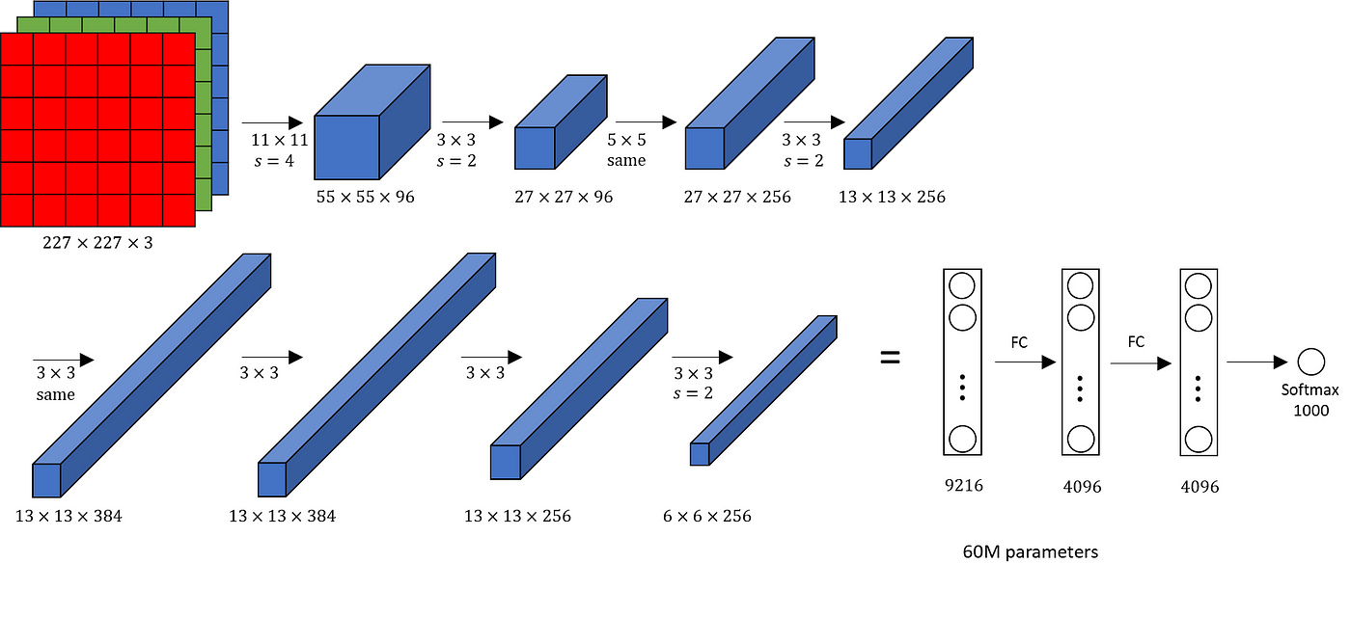
AlexNet Convolutional Architecture
‘ReLU’ is used as an activation function rather than ‘tanh’
Batch size of 128
SGD Momentum is used as a learning algorithm
Data Augmentation is been carried out like flipping, jittering, cropping, colour normalization, etc.
AlexNet was trained on a GTX 580 GPU with only 3 GB of memory which couldn’t fit the entire network. So the network was split across 2 GPUs, with half of the neurons(feature maps) on each GPU.

Slide 19
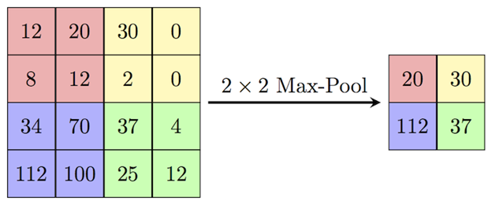
Max Pooling Layers
Purpose of Pooling Layers: To "accumulate" features from convolutional layers,
progressively reducing the spatial size of feature maps.
Benefits of Max Pooling:
Reduces the number of parameters and computations in the network.
Helps to mitigate overfitting by providing a more abstract representation.
Lowers computational cost by decreasing the number of learnable parameters.
Provides basic translation invariance to the internal representation.
Mechanism of Max Pooling: Applies a "max filter" to (usually) non-overlapping sub-regions of the input representation.
AlexNet's Approach: Used overlapping max pooling with 3x3 windows and a stride of 2.
Impact of Overlapping Pooling in AlexNet: Resulted in a reduction of the top-1 error rate by 0.4% and the top-5 error rate by 0.3% compared to non-overlapping pooling (2x2 windows with a stride of 2, yielding the same output dimensions).

Slide 20
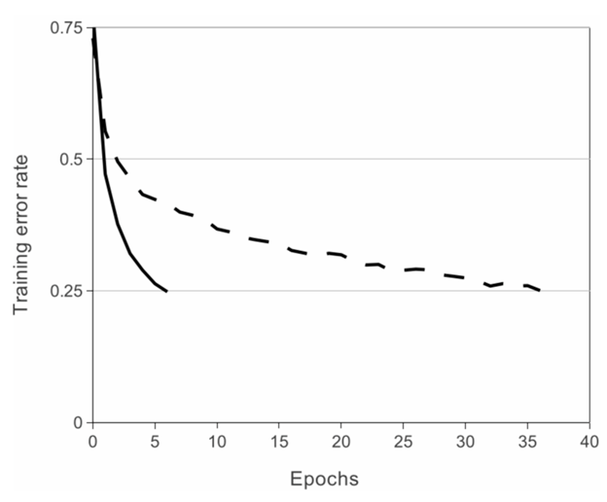
ReLU non-linearity in AlexNet:
AlexNet showed that using non-saturating activation functions like ReLU allows for significantly faster training of deep CNNs compared to saturating functions like Tanh or Sigmoid.
The text mentions that AlexNet achieved a 25% training error rate much quicker with ReLU (solid curve in an implied image).
Specifically, training with ReLU was approximately six times faster than with Tanh (dotted curve in the implied image), based on an evaluation on the CIFAR-10 dataset.

Slide 21
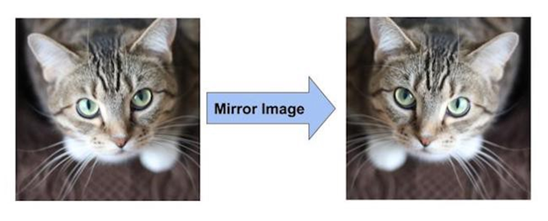
Data Augmentation techniques used in AlexNet:
Purpose of Data Augmentation: To prevent overfitting by exposing the neural network to different variations of the training images. It also effectively increases the size of the training data and forces the network to learn essential features rather than memorizing specific instances.
Augmentation by Mirroring: Flipping images (e.g., horizontally) creates new, but related, data points, effectively doubling the dataset size in the case of a simple vertical flip.

Slide 22
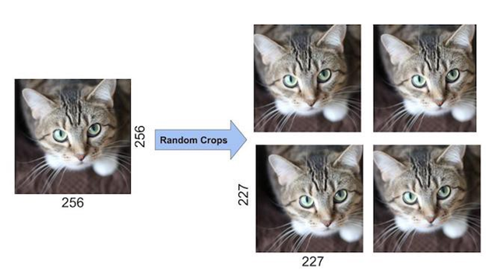
Data Augmentation techniques used in AlexNet:
3. Augmentation by Random Cropping: Randomly cropping portions of the original images generates shifted versions of the data.
AlexNet creators used this to extract 227x227 crops from the 256x256 image boundaries, increasing the dataset size by a factor of 2048.

Slide 23
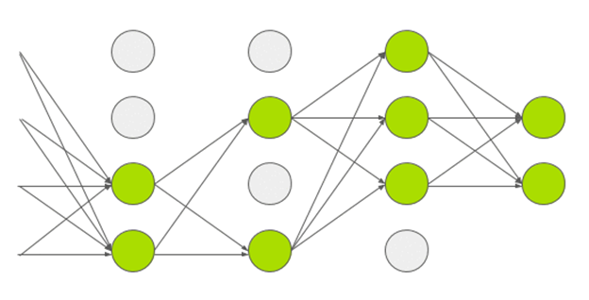
Dropout Technique: in AlexNet
Mechanism: During training, dropout randomly removes neurons from the neural network with a certain probability (e.g., 0.5).
Impact: Dropped-out neurons do not participate in the forward or backward propagation passes for that particular training iteration.
Effect: This forces the network to learn more robust features, as each input is effectively processed by a slightly different network architecture in each pass.
Benefit: The acquired weight parameters become more reliable and the model is less susceptible to overfitting the training data.

Slide 24
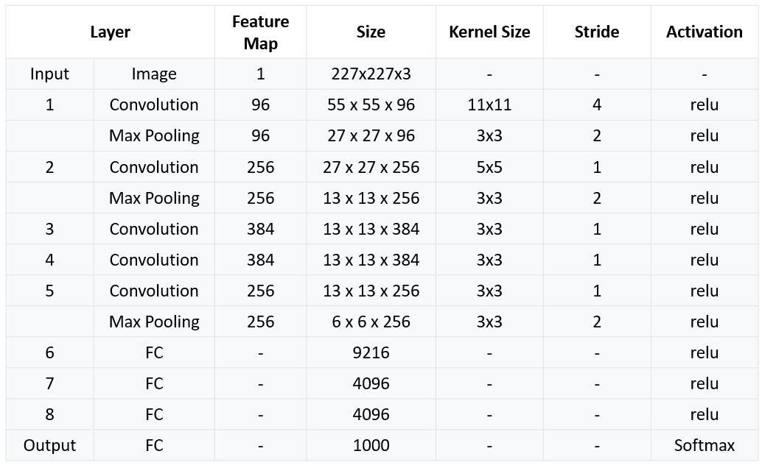
AlexNet Summary

Slide 25
Key Differences of LeNet and AlexNet Implementation
Feature | LeNet-5 | AlexNet
Input Size | 28x28 (MNIST original) | 227x227 (upscaled from 28x28)
Activation | Tanh | ReLU (faster convergence)
Pooling | Average Pooling | Max Pooling
Convolutional Layers | 2 layers | 5 layers
Filters | 6 → 16 filters | 96 → 256 → 384 → 384 → 256 filters
Dropout | Not used | Used in FC layers (0.5 dropout rate)
Optimizer | SGD | Adam (better for deep nets)
Kernel Sizes | 5x5 | 11x11, 5x5, 3x3
Strides | 1 (conv), 2 (pooling) | 4 (first conv), 2 (pooling)

Slide 26


Hands On Exercise
Click Here For The Implementation on Google Colab

Slide 27
Books and References
"Deep Learning" (Ian Goodfellow et al.)
"Neural Networks and Deep Learning" (Michael Nielsen)
Courses
Deep Learning Specialization (Andrew Ng, Coursera)
Fast.ai Practical Deep Learning
Datasets for Practice
MNIST (Handwritten digits)
CIFAR-10 (Image classification)
IMDB Reviews (Sentiment analysis)

Slide 28

















الشراكات العالمية

Slide 29
شــــــكــــرًا لكــــــم
THANK YOU

